Slide 1

Public Perception and Use of Hookah on Twitter in the US
Sponsor URMC CTSI : Zidian Xie
Academic Advisor: Prof. Ajay Anand
Team 10_CTSI_UR:
Yiwei Han
Puhua Ye
Mengwei Wu
Yuka Shimazaki

Slide 2

01.
Introduction
Background
Vision & Goals

Slide 3

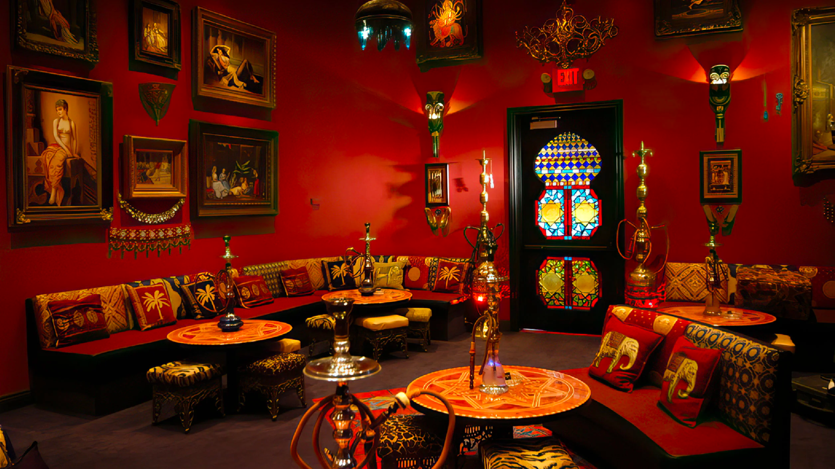
Background
Today, hookah cafés are gaining popularity around the globe, including Middle East, Britain, France, Russia and the United States.
In the US, nationwide, an estimated 590,000 high school students, or 4.1%, and 140,000 middle school students, or 1.2% had smoked hookah in the past month. According to one study, 79.6% of current hookah users aged 12-17 say that they use hookah because they like socializing while using the product. Hookah bars and cafes have grown in popularity, particularly in urban areas and around college campuses. In states or localities with smokefree laws, hookah bars often receive an exemption.

Slide 4
Project Vision + Project Goals
Project Vision: This project will provide us basic understanding about hookah perception, especially the hookah use, which will provide useful guidance for future hookah regulation and possible tobacco prevention campaigns.
Project Goals: .Understand public perception of Hookah and the Hookah use on Twitter in the US and promotion of hookah products on Twitter.

Slide 5
02.
Project Overview
Milestone

Slide 6





Step.01
Step.02
Step.03
Step.04
Step.05
Preprocess and Filter Twitter Data
Visualization and Key-insight
Commercial Tweet Analysis
Human-Label
Model
Keyword filtering
Human label attitude and user_or_not
RoBERTa
Llama 2
Visualize the result and find interesting story
Topic Modeling
Hookah brand Analysis

Slide 7
03.
Data Overview
Data Format
Keyword Filtering

Slide 8
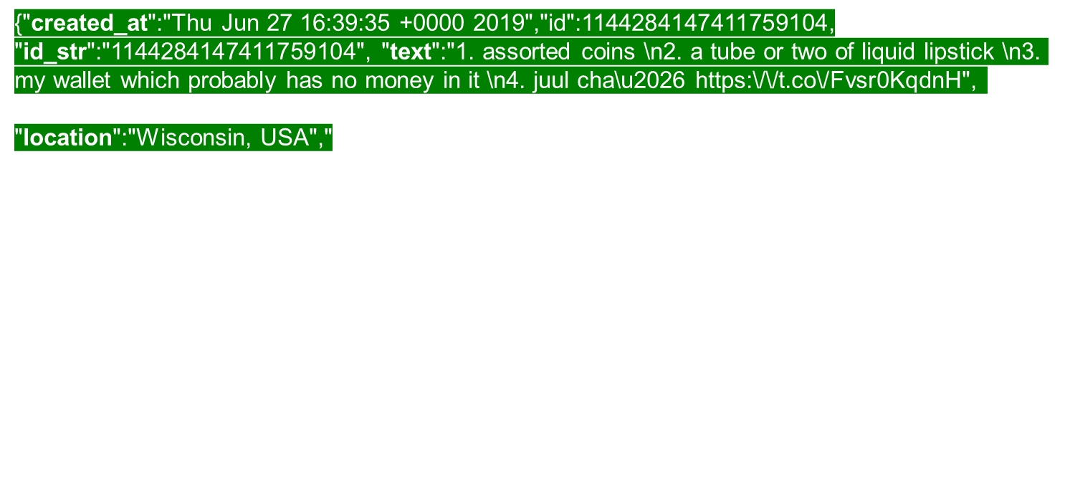
Twitter Data Format

Slide 9
Twitter data keyword filtering
The total number of tweets in US is 927,290
The total number of Hookah-related tweets is 323,347
The total number of non-commercial tweets is 299,544
The total number of commercial tweets is 23,803

Slide 10
04.
Commercial Tweet Analysis
Topic Modeling
Hookah Brand Analysis

Slide 11
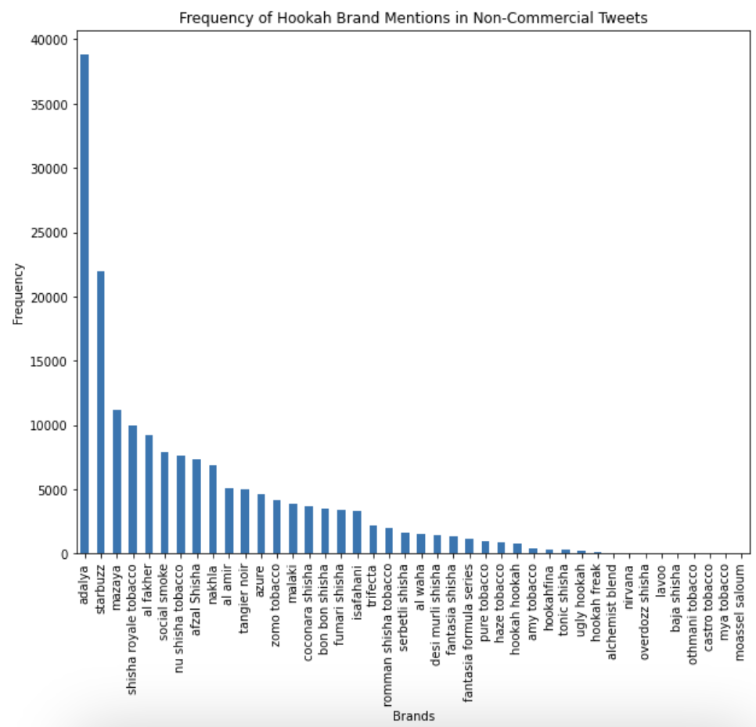
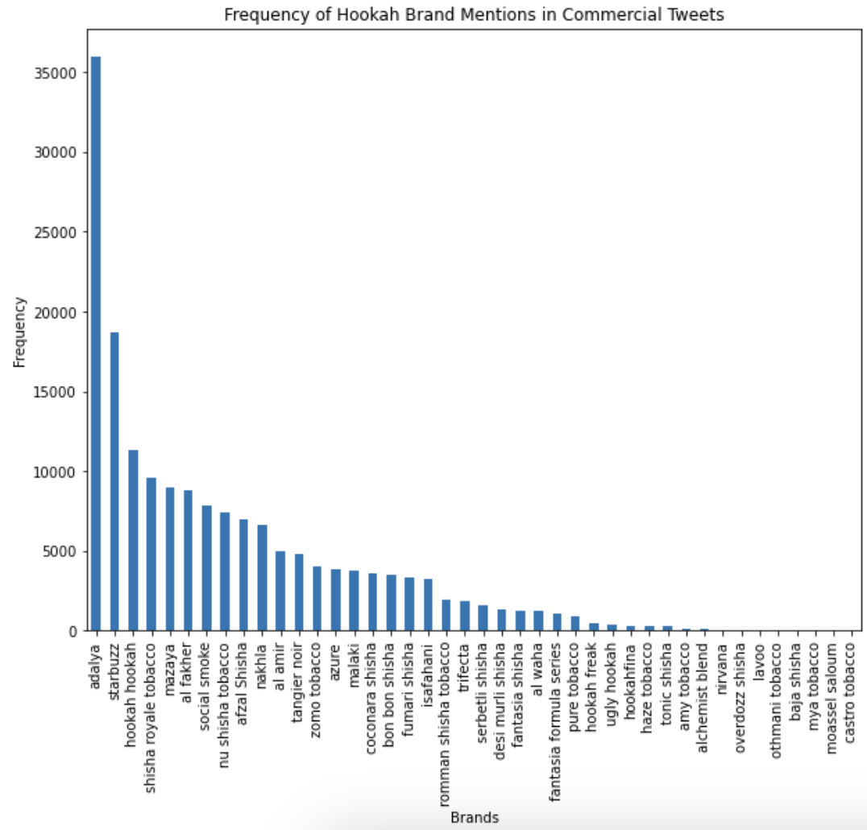
Top Hookah Brand Frequency in Commercial and Non-commercial Tweets
The Top 2 brands in both commercial and non-commercial Tweets are Adalya and Starbuzz, with Adalya takes over half of the market share.
The Top 3 brand for commercial Tweets is Hookah Hookah, while this brand falls lot behind in the non-commercial Tweets, indicating Hookah Hookah does a lot of ads and promotions to attract customers

Slide 12
Top 5 Topics of Bertopic Modeling for Commercial Tweets
Topic Summary | Topic keywords | Example tweets in topic
The topic is related to nightlife events, which providing a combination of entertainment and dining. | free, night, tonight, bottles, hookah, shots, tuesday, food, tacos, drinks | Tonight ladies free by 11pm Ladies free hookah in groups $125 bottles till 11pm 🍾🍾 https://t.co/9ea3ab8gw1
This topic is clearly related to the sale of hookah-related products. | hookah, store, selling, niggas, sell, like, dollars, prices, nigga, paying | Dallas! Selling hookah cups and candy tips this weekend… #Dallas #hookah https://t.co/5Zwg07gRaa
This topic is associated with parties and night entertainment at Thursday, Friday, and Saturday, especially mentioned ladies have free admission. | party, ladies, happy, night, thursday, free, tonight, therapy, friday, saturday | 📷 EVERY THURSDAY it’s Hookah / Ladies night, PLEASE HONOR ALL CDC RULES AND GUIDELINES RELATED TO COVID-19 ————————… https://t.co/76pz1hz3Ec
This topic is about lounges and clubs that offer hookah, drinks and food, especially in cities like Atlanta and Miami. | lounge, hookah, atlanta, drinks, liquor, miami, food, lounges, club, like | Stop by the hookah lounge tonight.. Then slide for bit to eat $20 Smoke &amp; Eat $50 All you can EDS https://t.co/Q3ndvcJtqd
This topic focuses on smoking-related products, including hookah, weed, and tobacco, as well as the sale or promotion of various flavored products. | smoke, smoking, tobacco, hookah, vape, flavored, products, weed, flavor, flavors | Smoke Shop (Black) Swooper Feather Advertising Flag &amp; Pole Kit – Perfect for Smoke Shops, Vape Stores, Hookah Spots https://t.co/RWPiWOepnO

Slide 13
Top 5 Topics of LDA Modeling for Commercial Tweets
Topic Summary | Topic keywords | Example tweets in topic
This topic revolves around night events with Hookah, especially with free admission for ladies. | free, hookah, tonight, night, ladies, open, specials, drink, drinks, entry | Ladies free hookah in groups $125 bottles till 11pm 🍾🍾 https://t.co/9ea3ab8gw1
This topic is related to selling hookah stores. | hookah, smoke, like, store, shisha, lounge, smoking, need, sell, good | Selling my hookah, coals (box of 100), hookah coal burner, and shisha. Make me an offer https://t.co/zb52dVChOm
This topic is related to the promotion of waterpipe types and new products. It’s about the innovation of new flavors and the material of water pipes. | hookah, waterpipe, available, party, glass, durable, engineered, smoothest, revolutionary, pipe | @QAce420 Engineered to be the smoothest, most durable, and revolutionary waterpipe available!… https://t.co/EYarDApxxb
The topic focuses on the customer experience, using posted photos to emphasize the love for hookah and the flavor of hookah to promote hookah and its flavors. | hookah, come, happy, flavor, posted, photo, love, perfect, restaurant, shop | Just posted a photo @ Mangos Bar, Hookah &amp; Restaurant https://t.co/qFi8Mwj7DV
This topic focuses on the promotion of hookah lounge party events. | hookah, sunday, lounge, come, food, drinks, music, back, party, link | $20 mint hookah ALL night $5 shots til 11pm! @HollywoodLounge Tonight!!! https://t.co/mmTRimlvL0

Slide 14
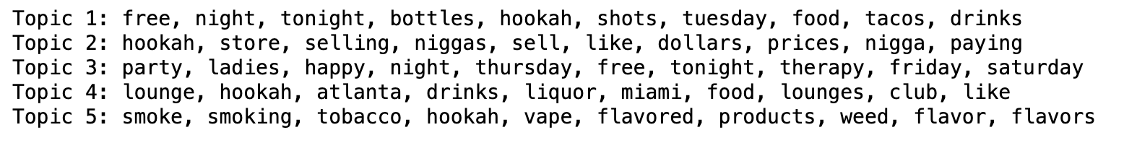
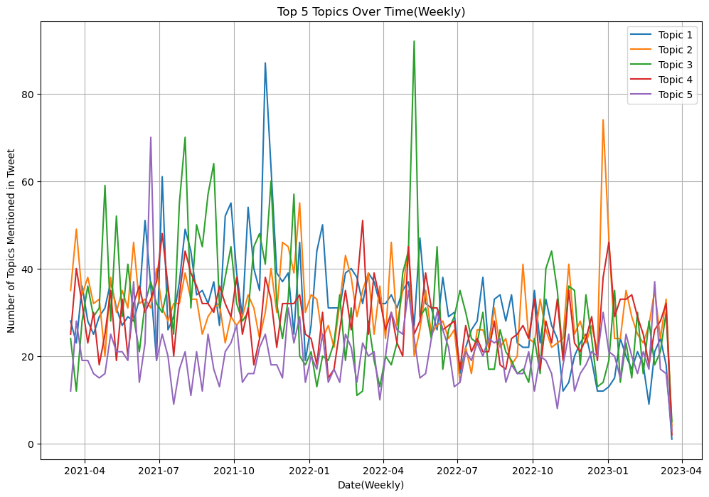
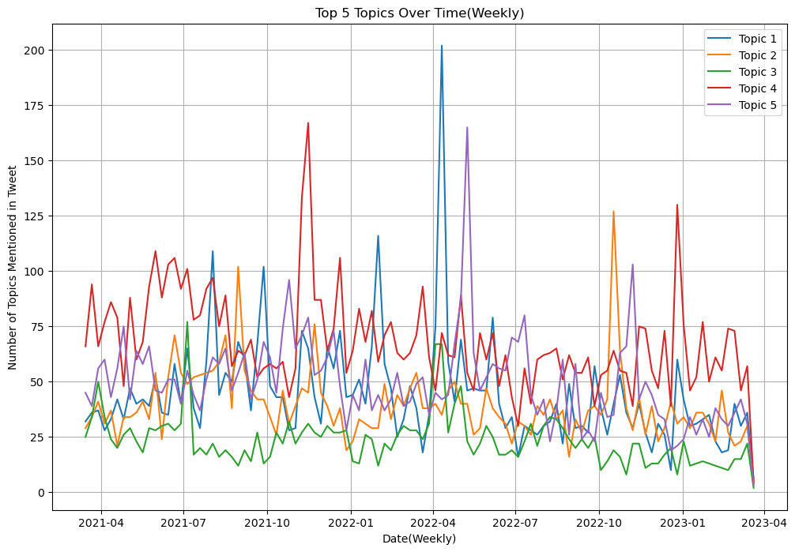
Top 5 Topics of Bertopic and LDA Modelling for Commercial Tweets Time Series
Bertopic
LDA
The overall trends of Bertopic and LDA modelling are similar. Both of them have the peak in April 2022 : Topic 3 (Bertopic) and Topic 1 (LDA), and overall trends appear to decline around March 2023.
Topic 3 in bertopic is associated with social events at Thursday, Friday, and Saturday night, particularly targeted at ladies.
Topic 1 in LDA is also related to the night events for ladies, similar to the Topic 3 in Bertopic.

Slide 15
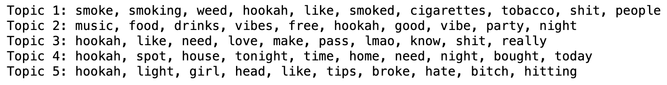
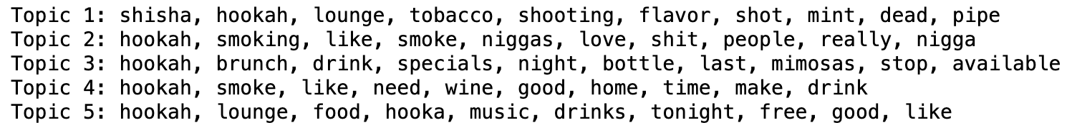
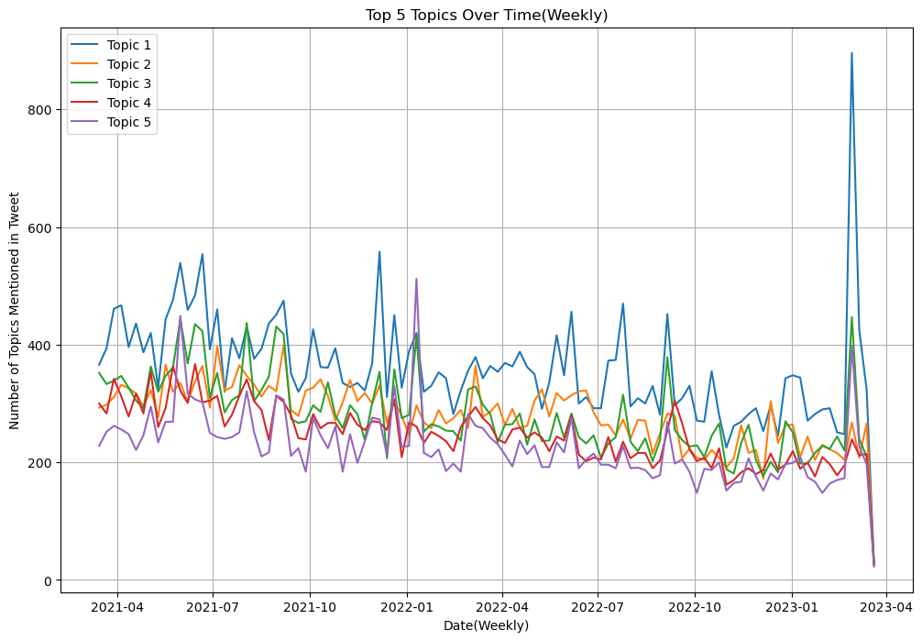
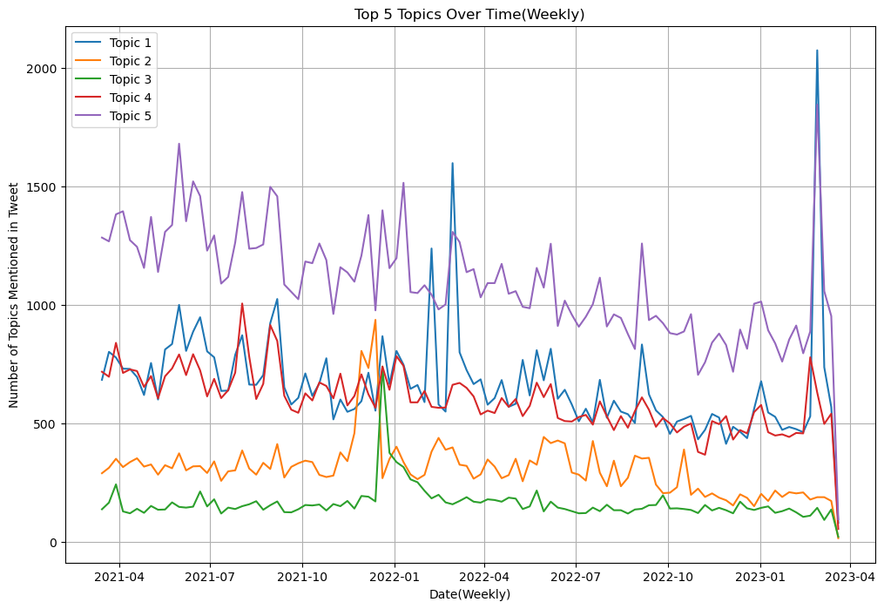
Top 5 Topics of Bertopic and LDA Modeling for Non-Commercial Time Series
Bertopic
LDA
The peak in both of bertopic and LDA modelling (Topic 1) occurred in March 2023, then the trend starts declining.
Topic 1 in bertopic modeling is related to hookah, smoking hookah, weed, and cigarettes.
Topic 1 in LDA is also related to the hookah, hookah lounge, and hookah flavors, similar to the topic 1 in bertopic.

Slide 16
05.
Technical Approach and Results
Human Labeling
Data Engineering
Llama 2
EDA
RoBERTa

Slide 17
Human Labelling
Label 100 Tweets together and set up rules
Label 300 separately, compute Kappa value (<0.7)
Went over the those 300 Tweets together
Label another 300 Tweets separately and compute Kappa Value (>0.7)
Label different 400 tweets individually

Slide 18
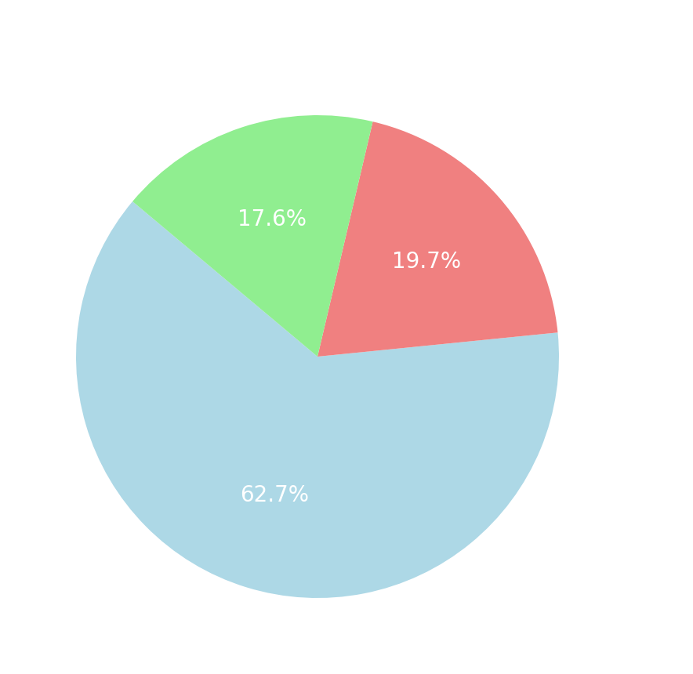
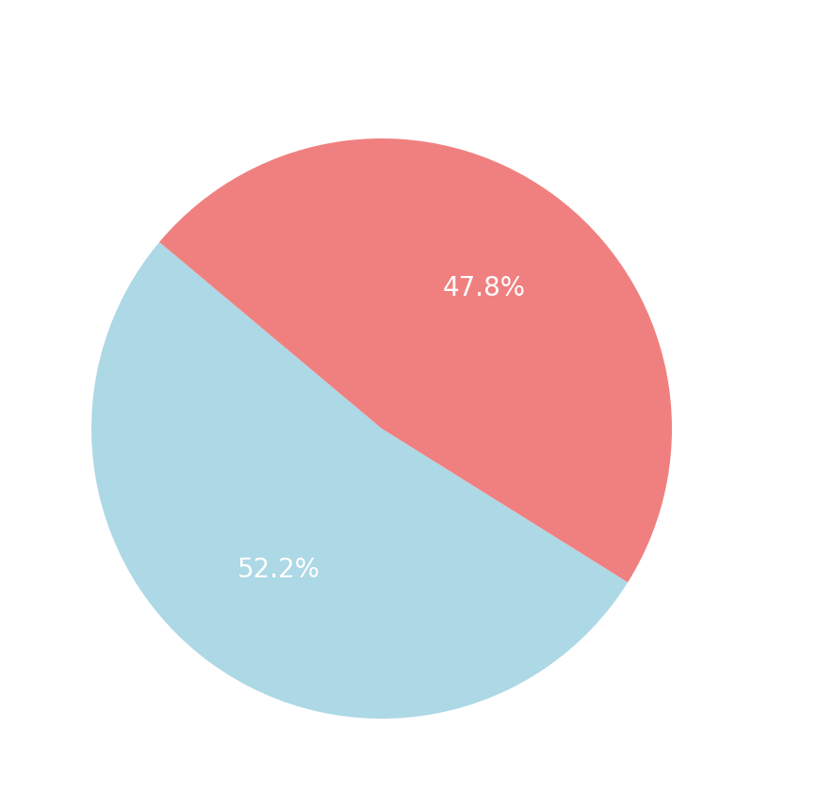
EDA: Distribution of Attitude & User_or_not
Imbalanced Distribution !!!

Slide 19
Data Engineering: Data Augmentation
Synonym Replacement: Replace words with their synonyms.
Back Translation: Translate text to another language and then back to the original language.
After Data Augmentation:
Total: 14365
Negative: 2403
Neutral: 2916
Positive: 9046

Slide 20
Data Engineering: Undersampling
Over-sampling can lead to a large amount of duplicate data, thereby increasing the risk of overfitting.
Randomly deleted Tweets from our augmented dataset to achieve a balanced dataset
After Undersampling:
Negative: 2403
Neutral: 2916
Positive: 3000

Slide 21
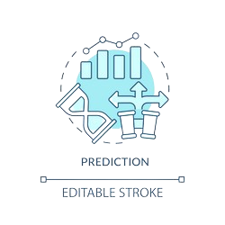


Model: Roberta
What is Roberta:
RoBERTa is a pre-trained language model that can be fine-tuned on specific tasks, where it generates embeddings that can be utilized in further model layers.
RoBERTa is trained on a larger and more diverse dataset than BERT
RoBERTa eliminates the Next Sentence Prediction task used in BERT, focusing solely on the Masked Language Model task.
RoBERTa uses larger batch sizes and longer training, differing from BERT's original setup.

Slide 22
Model: Roberta
Model Structure:
Processes the input data using the pre-trained RoBERTa architecture to extract relationships in data
The first token contains the aggregated understanding of the sequence.
A linear layer that further processes the hidden state of the first token.
Implements dropout, a form of regularization. During training, some neuron outputs are randomly ignored.

Slide 23
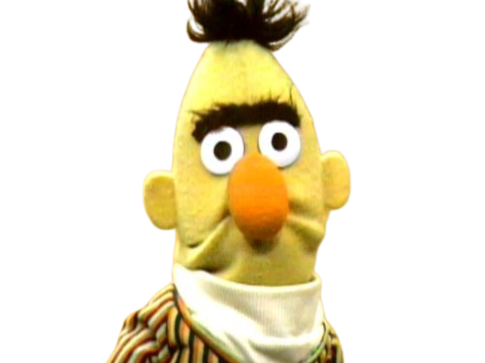
Model: Roberta
Result (accuracy):
 | Original Dataset | Augmented Dataset | Augmented Balanced Dataset
Attitude | 70.34% | 69.54% | 71.79%
User_or_not | 79.78%
RoBERTa model is not as good as expected and does not meet the 80% standard
We also adjusted the structure of the model, e.g., adding different neural network structures, but there was not a great deal of improvement

Slide 24
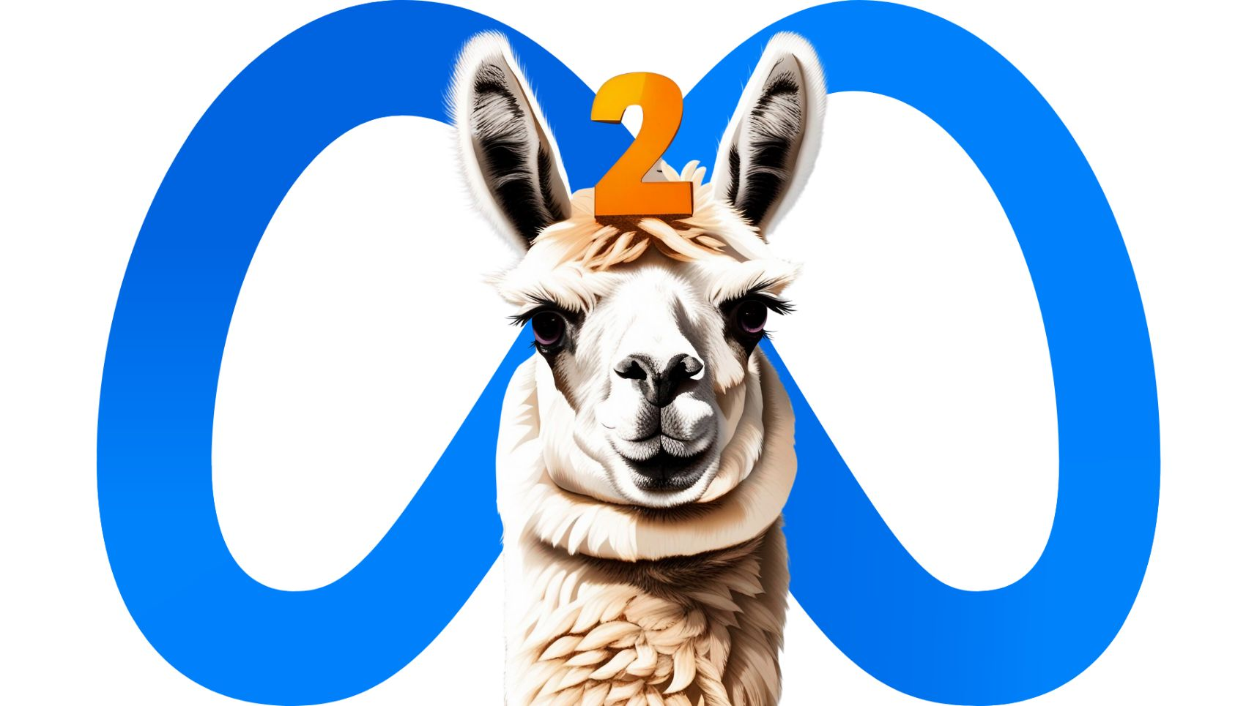
Model: Llama 2

Slide 25

Model: Llama 2
Model Architecture and Versions: Llama2 is an autoregressive transformer-based language model. It comes in different versions with varying parameters: 7 billion, 13 billion, and 70 billion. We used 7b version.
Training and Data: The model was trained on 2 trillion tokens from publicly available online data sources.
Performance and Benchmarks: Llama 2 excels in various benchmarks like AGIEval, MMLU, and Winogrande, surpassing other models in reasoning and comprehension
Licensing and Access: The model is available under a custom commercial license

Slide 26
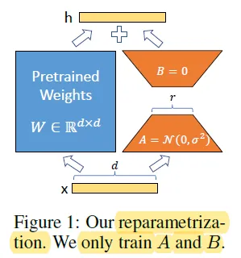
Model: Llama 2
Fine-tuning:
PEFT (LoRA)
Concept of LoRA: LoRA is a method for fine-tuning large pre-trained models, especially in natural language processing, by adding low-rank matrices to the model's weights.
Low-Rank Matrices: These matrices are smaller in size (low-rank) compared to the original model weights, enabling efficient parameter modification without the need to adjust the entire model.
Integration with Pre-trained Weights: Instead of replacing the original weights, low-rank matrices are integrated with them, typically through matrix operations, to modify the model's behavior for specific tasks.

Slide 27
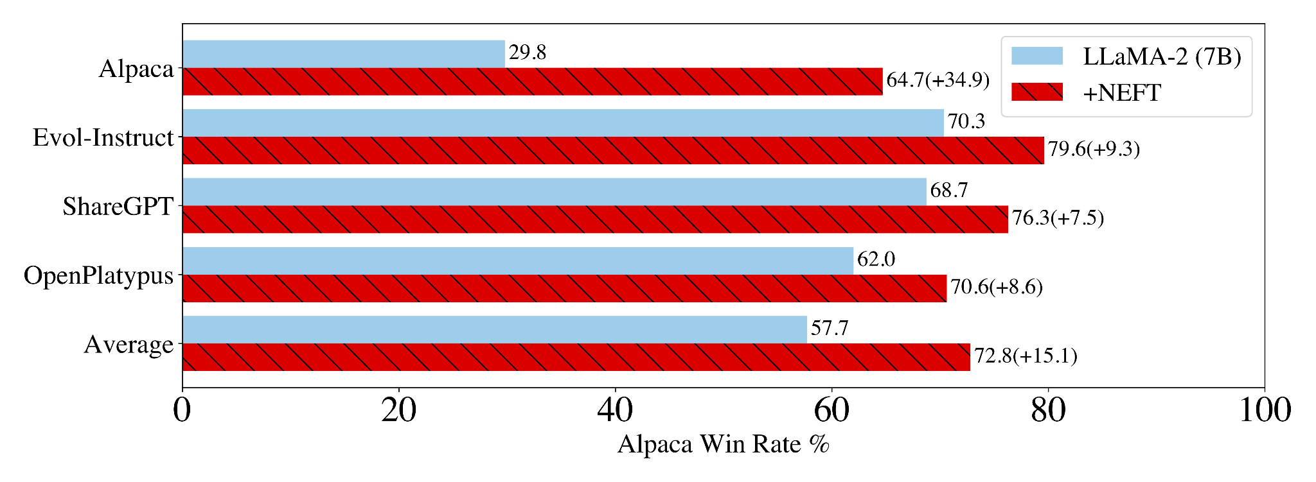
Model: Llama 2
Optimization:
NEFT (noise embedding fine tuning)
Methodology:NEFTune is a fine-tuning technique that introduces random noise to the embedding vectors during the forward pass of model training.
Results and Impact:This addition of noise significantly enhances the performance of large language models (LLMs) on instruction-following tasks without additional computational or data resources. For instance, NEFTune fine-tuning improved the performance of the LLaMA-2-7B model on the Alpaca dataset from 29.8% to 64.7%.
Implementation with SFTTrainer: NEFTune can be implemented with SFTTrainer for fine-tuning tasks.

Slide 28

Model: Llama 2
Result:
Attitude | Accuracy | F1-Score
Llama 2-7b | 47.3% | 0.407
Fine-tuned Llama 2-7b | 74.4% | 0.75
Fine-tuned Llama 2-7b(+NEFT) | 81.1% | 0.816
User_or_not | Accuracy | F1-Score
Llama 2-7b | 52.8% | 0.51
Fine-tuned Llama 2-7b | 86.3% | 0.86

Slide 29
06.
Visualization & Insights
Basic Analysis
Time-series Analysis
Geographical Analysis
Heatmap
Emoji Analysis

Slide 30
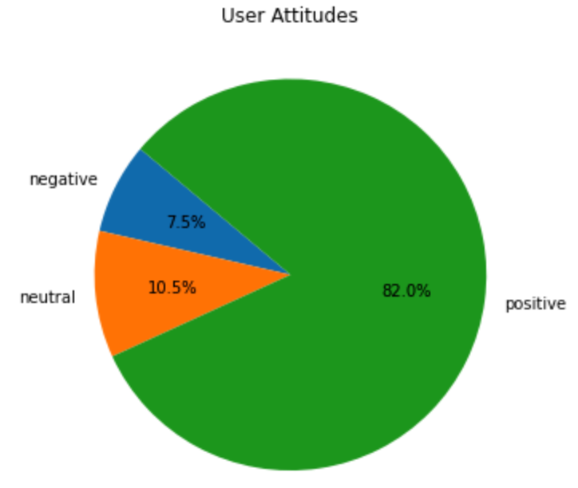
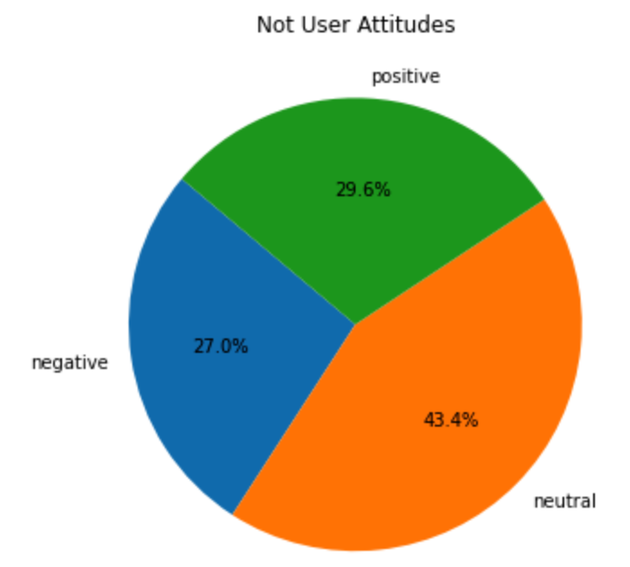
Pie Chart:
User + Attitude Analysis
For users, the majority of the Tweets have a positive attitude, while neutral and negative attitudes take up less than 20%
For non-users, the attitudes are more evenly distributed, with most of neutral attitudes and least of the negative attitudes.

Slide 31
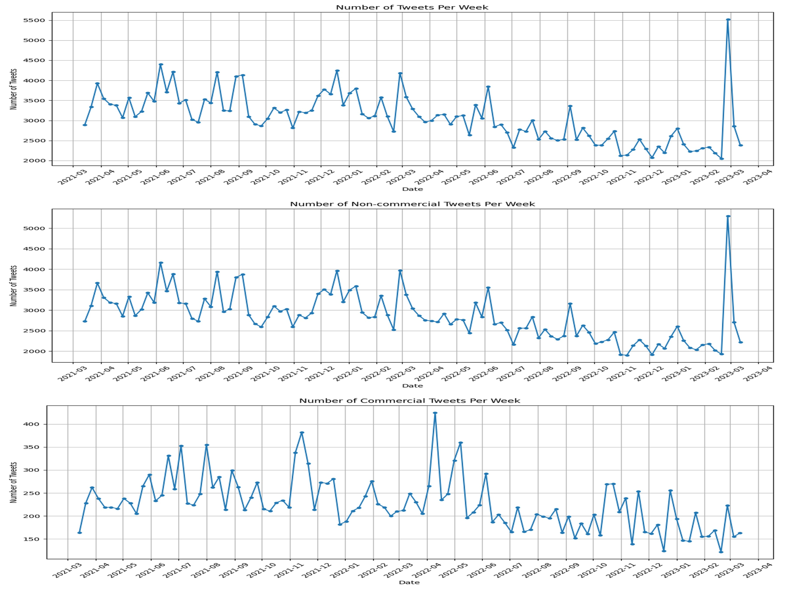
Time series analysis: Number of Tweet
Number of Tweets per week is steady throughout our time series analysis in general
Abnormality occurs at March, 2023, in which the Non-Commercial Tweets has a peak, resulting in the peak of total number of Tweets as well

Slide 32
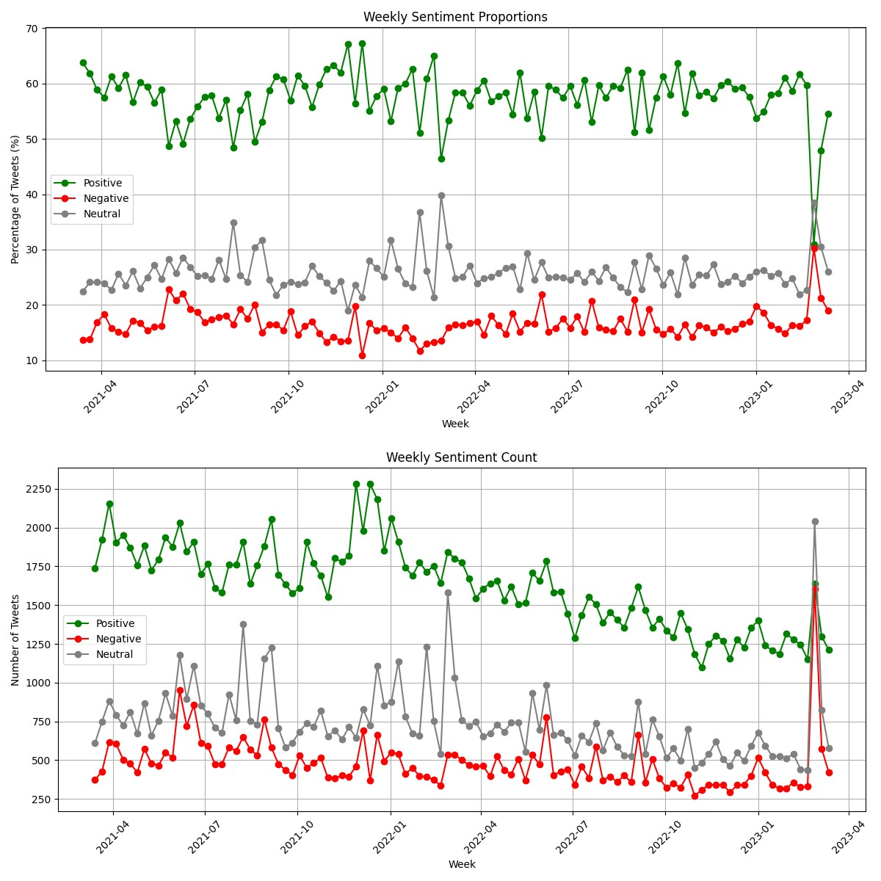
Time series analysis: Number of Tweet by attitude
Possible explanations for the significant peak of number of Tweets in March 2023, and the inverse attitudes among Tweet
A group of 4 friends in Detroit ended up in the hospital with carbon monoxide poisoning after smoking hookah
Reports of violence and criminal activities linked to hookah lounges, including a man was reportedly hit with a hookah pipe during an alcohol theft, man charged in shooting outside hookah bar near Temple University
Discussions about the general health hazards of hookah smoking gained prominence, especially second hand

Slide 33
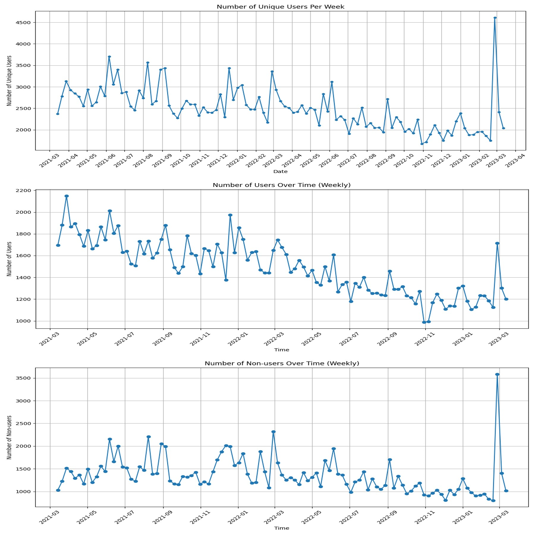
Time series analysis: Number of unique user
Number of unique user and non-user tend to be steady over time
Number of User only tend to decrease
Unique User, user and non-user all have a peak in March 2023, indicating and abnormality, align with the past two time series analysis

Slide 34
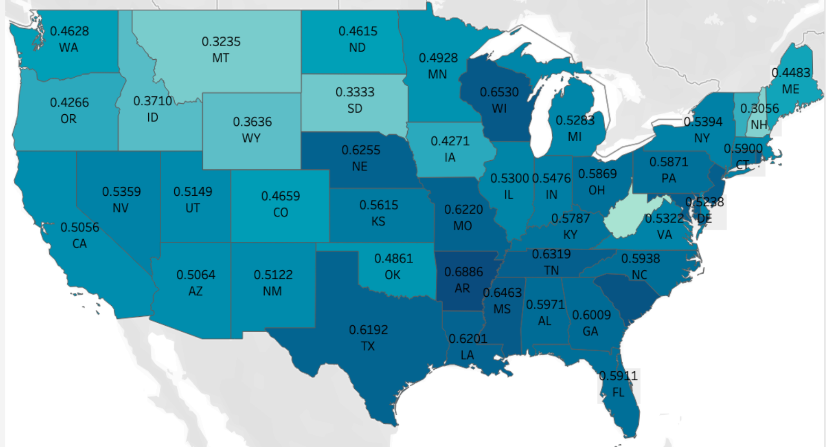
Map Visualization:
Positive Attitude Rate per State
Arkansas has the highest positive rate while West Virginia has the lowest positive rate
States in the south and east part of US have higher positive attitude rate than states from the north and west coast

Slide 35
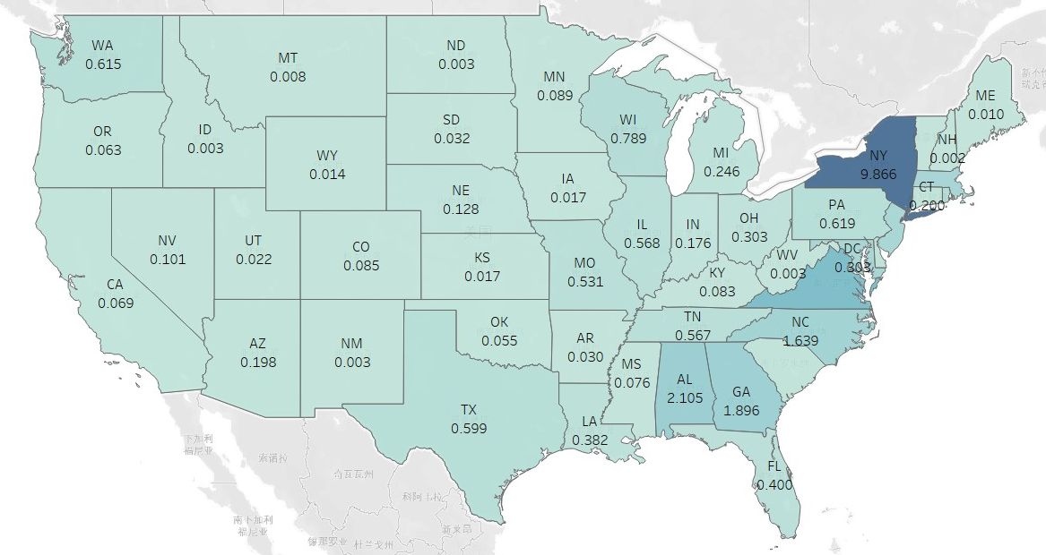
Map Visualization:
Normalized State Hookah User Count
This map shows the unique hookah user normalized by the whole population of the corresponding state
States in the east part tend to have more hookah user, with New York an outlier with the most proportion of hookah users

Slide 36
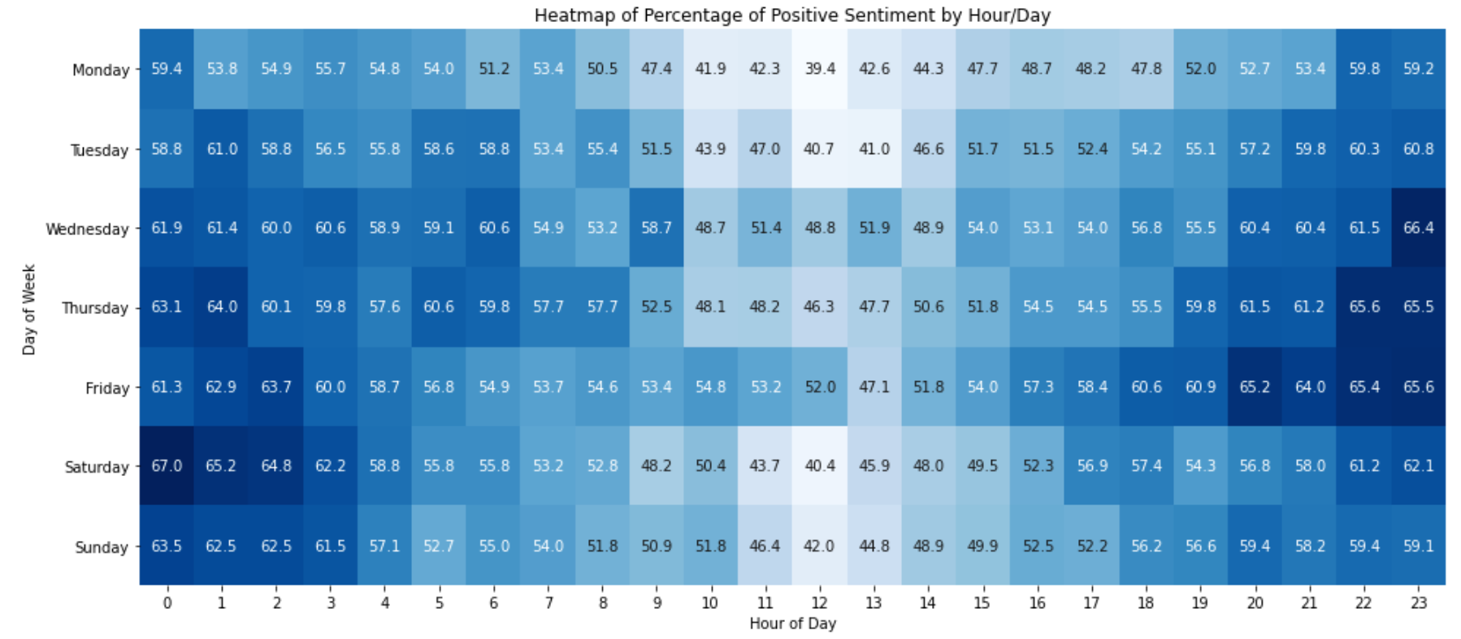
Heat Map Visualization:
Positive Attitude Rate Across Day and Time
People in the day-time of weekdays tend to have less positive attitudes towards Hookah.
People in the evening to night, especially during the weekends tend to be more positive towards Hookah.

Slide 37
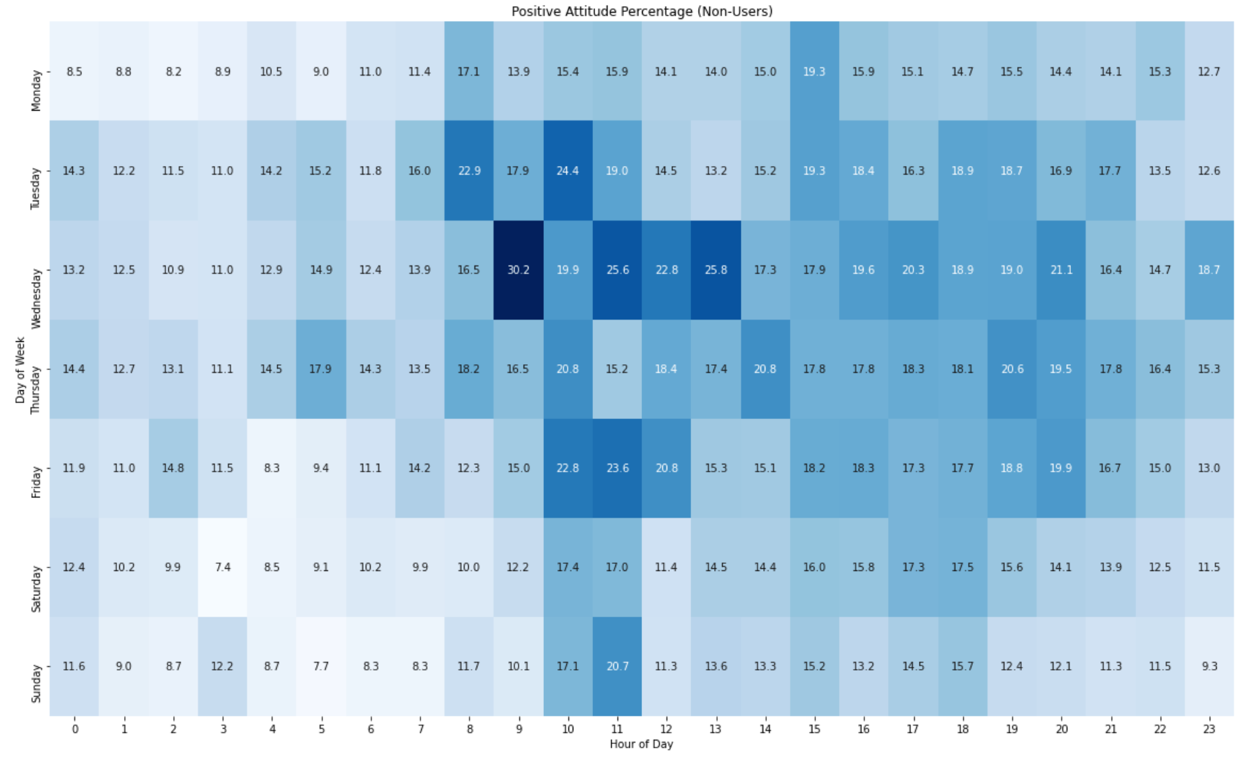
Heat Map Visualization:
Non-User Positive Attitude Rate Across Day and Time
For non-user, the most proportion of positive attitude towards Hookah is during day-time of weekdays, especially Wednesday.
For night-time, especially weekends, non-users tend to have the least positive attitudes toward Hookah, indicating they might have been negatively influenced by it.

Slide 38
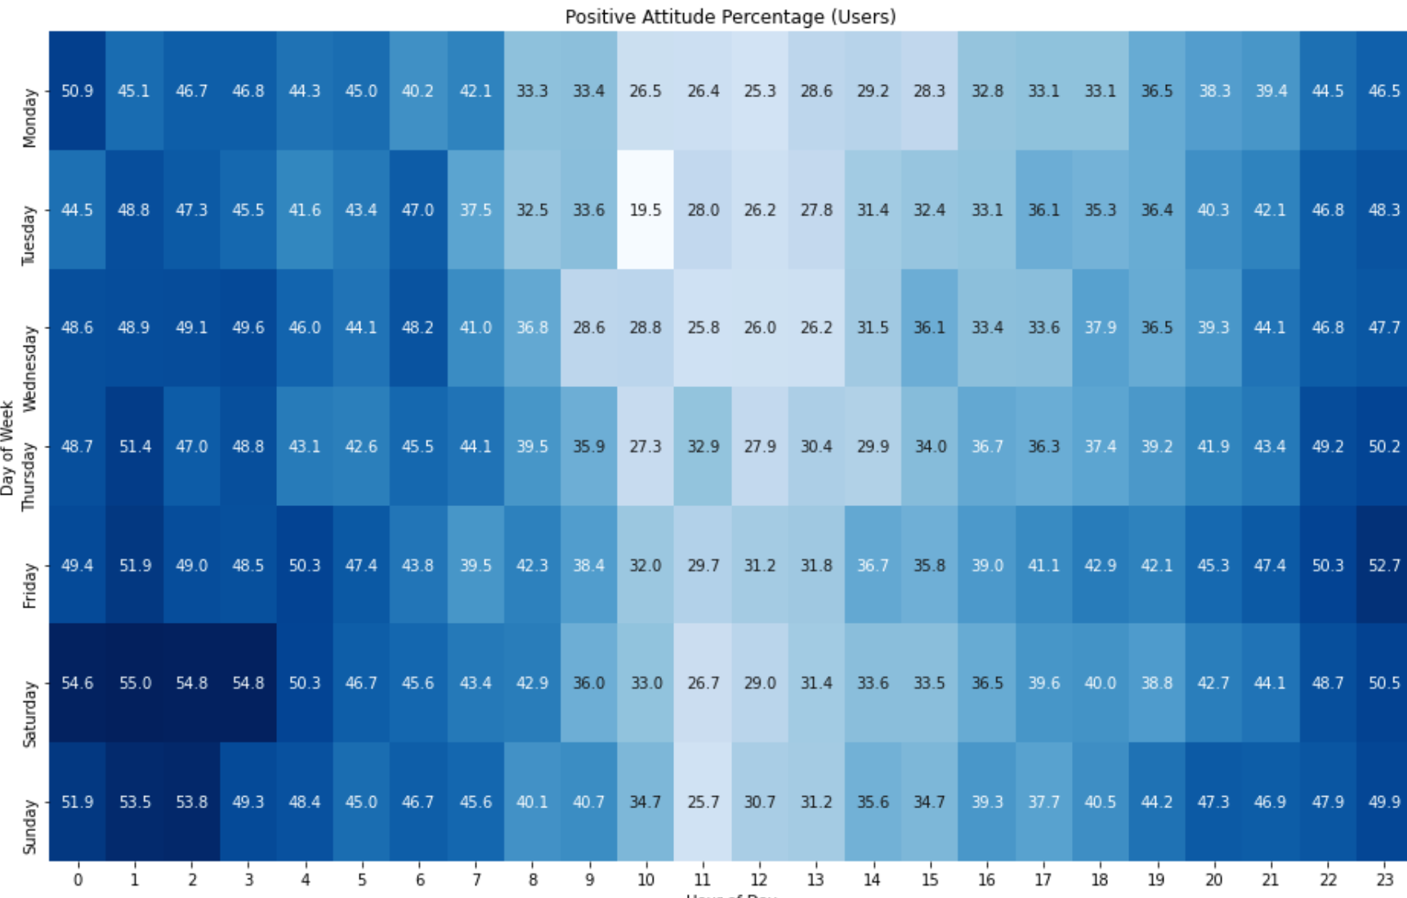
Heat Map Visualization:
User Positive Attitude Rate Across Day and Time
For user, the most proportion of positive towards Hookah is during night-time of weekends, especially Saturday, when they are more likely to consume Hookah and feel happy.
For day-time, especially week days, users tend to have the least positive attitudes toward Hookah, indicating they might not smoke Hookah which makes them high.

Slide 39
Emoji Analysis
 | Positive |  | Neutral |  | Negative |  | Commercial
 | Emoji | Count | Emoji | Count | Emoji | Count | Emoji | Count
1 | 😂 | 22187 | 😂 | 7376 | 😂 | 20409 | 😂 | 20202
2 | 😭 | 14829 | 😭 | 5668 | 😭 | 11090 | 😭 | 10978
3 | 💨 | 7304 | 🤣 | 1590 | 🤣 | 6616 | 🤣 | 6566
4 | 🤣 | 6142 | 🥴 | 1086 | 🚩 | 2275 | 🚩 | 2274
5 | 🔥 | 5286 | 😩 | 952 | 💀 | 1296 | 💀 | 1287
6 | 😩 | 4976 | 🚩 | 898 | 😩 | 1006 | 😩 | 1001
7 | 😍 | 4958 | 💀 | 883 | 🥴 | 877 | 🥴 | 875
8 | 🍾 | 4521 | 🚹 | 642 | 🙄 | 866 | !! | 858
9 | 🥳 | 3222 | ❌ | 608 | 🚹 | 772 | 🤦 | 765
10 | !! | 3127 | 🤦 | 600 | 🤦 | 769 | 🚹 | 765
Neutral, negative attitudes, and commercial Tweets tend to have similar Top 10 emojis used in Tweets
Positive attitude Tweets Top 10 emojis show happier and higher sentiments

Slide 40
07.
Challenge

Slide 41

Labeling
Labelling can be very subjective and time consuming
Without context, it can be hard to hypothesize the emotion of the tweets
Some of the tweets can be hard to understand as there are many Hookah-related slangs
Mixed sentiment analysis: some tweets have both positive and negative emotions
It took five rounds of setting rules for attitude and user or not column to achieve a kappa value above 0.7

Slide 42
Challenges during RoBERTa Model
Tried 4 different model architectures, could not improve accuracy
Data Augmentation does not improve model accuracy
Tried different hyperparameters, accuracy does not improve much
RoBERTa model might not be suitable and robust for our dataset

Slide 43
Challenges during Fine-tuning Llama2
Fine-tuning Llama2 necessitates substantial computational resources, incurring significant training costs.
Learning to fine-tune large models from scratch is a complex undertaking.
The abundance of hyperparameters complicates the tuning process.
Training 300K text dataset is very time consuming. Each training takes 20+ hours.
GoogleColab interrupts a lot, multiple training steps.

Slide 44
08.
Next Steps

Slide 45

Utilize our results to provide useful guidance for future hookah regulation and possible tobacco prevention campaigns
Gather Hookah User image data to perform the facial recognition algorithm to identify the demographics of the users, regulate on the underages hookah usage condition and formulate policies

Slide 46


THANKS
Do you have any questions?
Zidian Xie
Professor Ajay Anand
Professor Cantay Caliskan

